Slide 1
Online Food Ordering Website
TEAM # 24

Slide 2
WHY THIS APP ?
Increase the scope of business.
New in a town
Guest
Time and resource saving

Slide 3
SCOPE
Online Food Order Application
Facilitate Customers
Buyers and Sellers
Easy to Use
Interactive Application Interface
Cash On Delivery

Slide 4
MEAN STACK
Angular (Front end)
Node JS & Express (Backend Engine)
MongoDB (Database)
PHP for Admin Panel

Slide 5
FEATURES
USER SIGN IN/SIGN UP
ADMIN PANEL
ORDERS HISTORY
RESTAURANT MENU

Slide 6
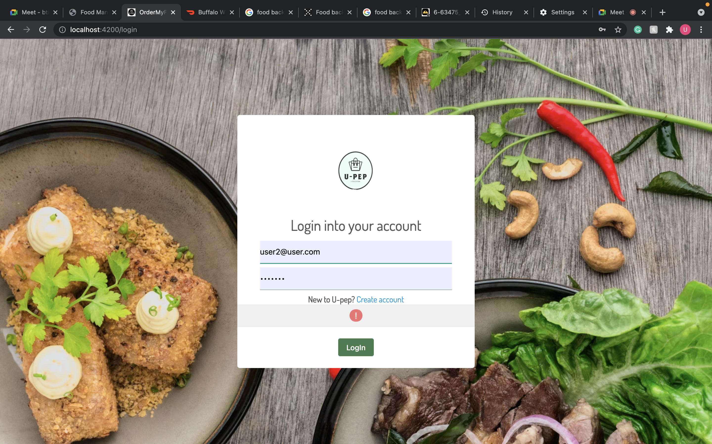
LOGIN PAGE

Slide 7
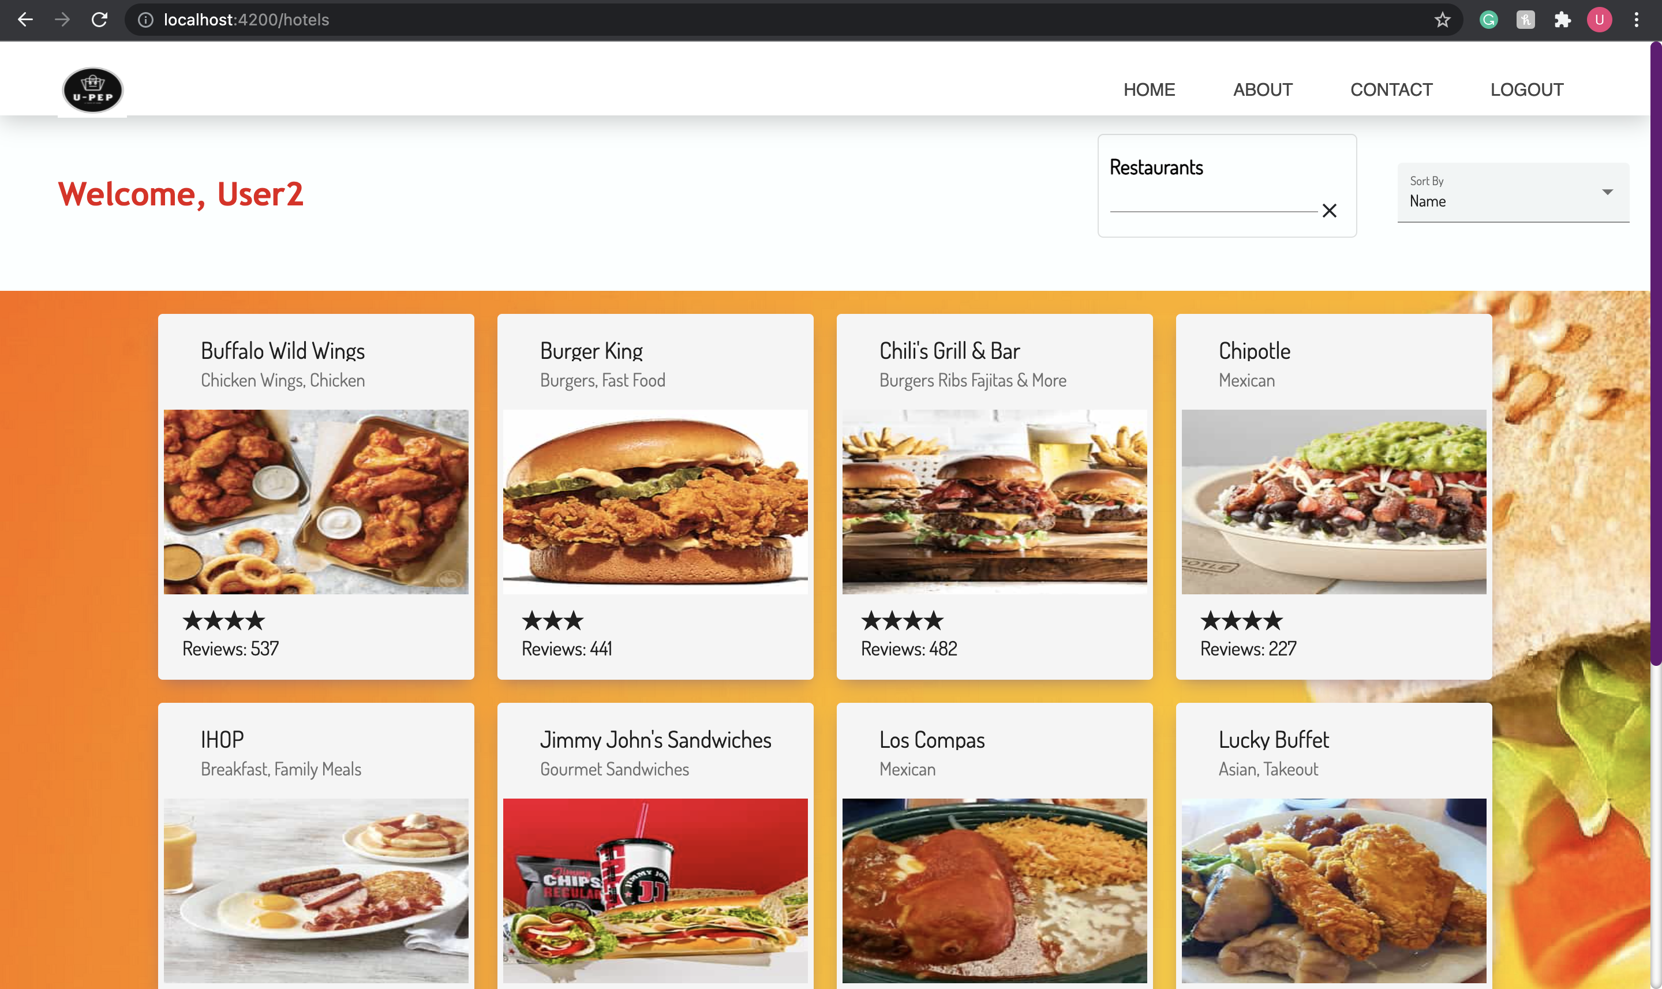
HOME PAGE

Slide 8
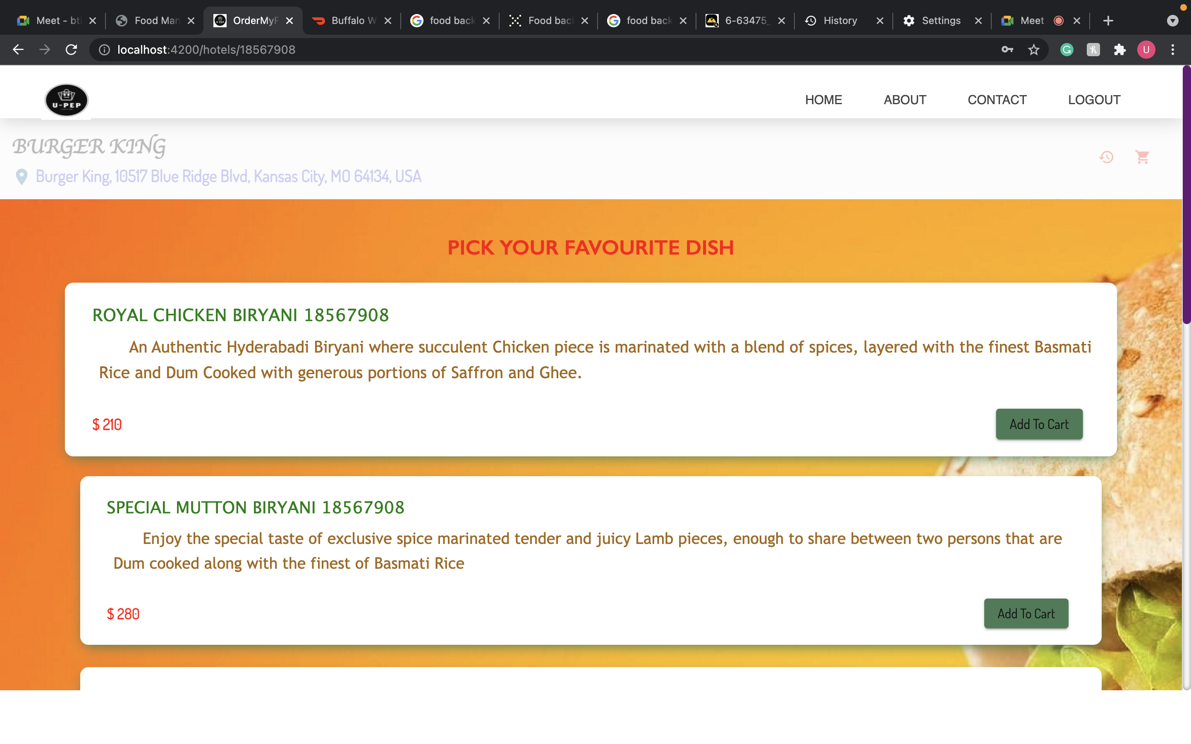
MENU PAGE

Slide 9
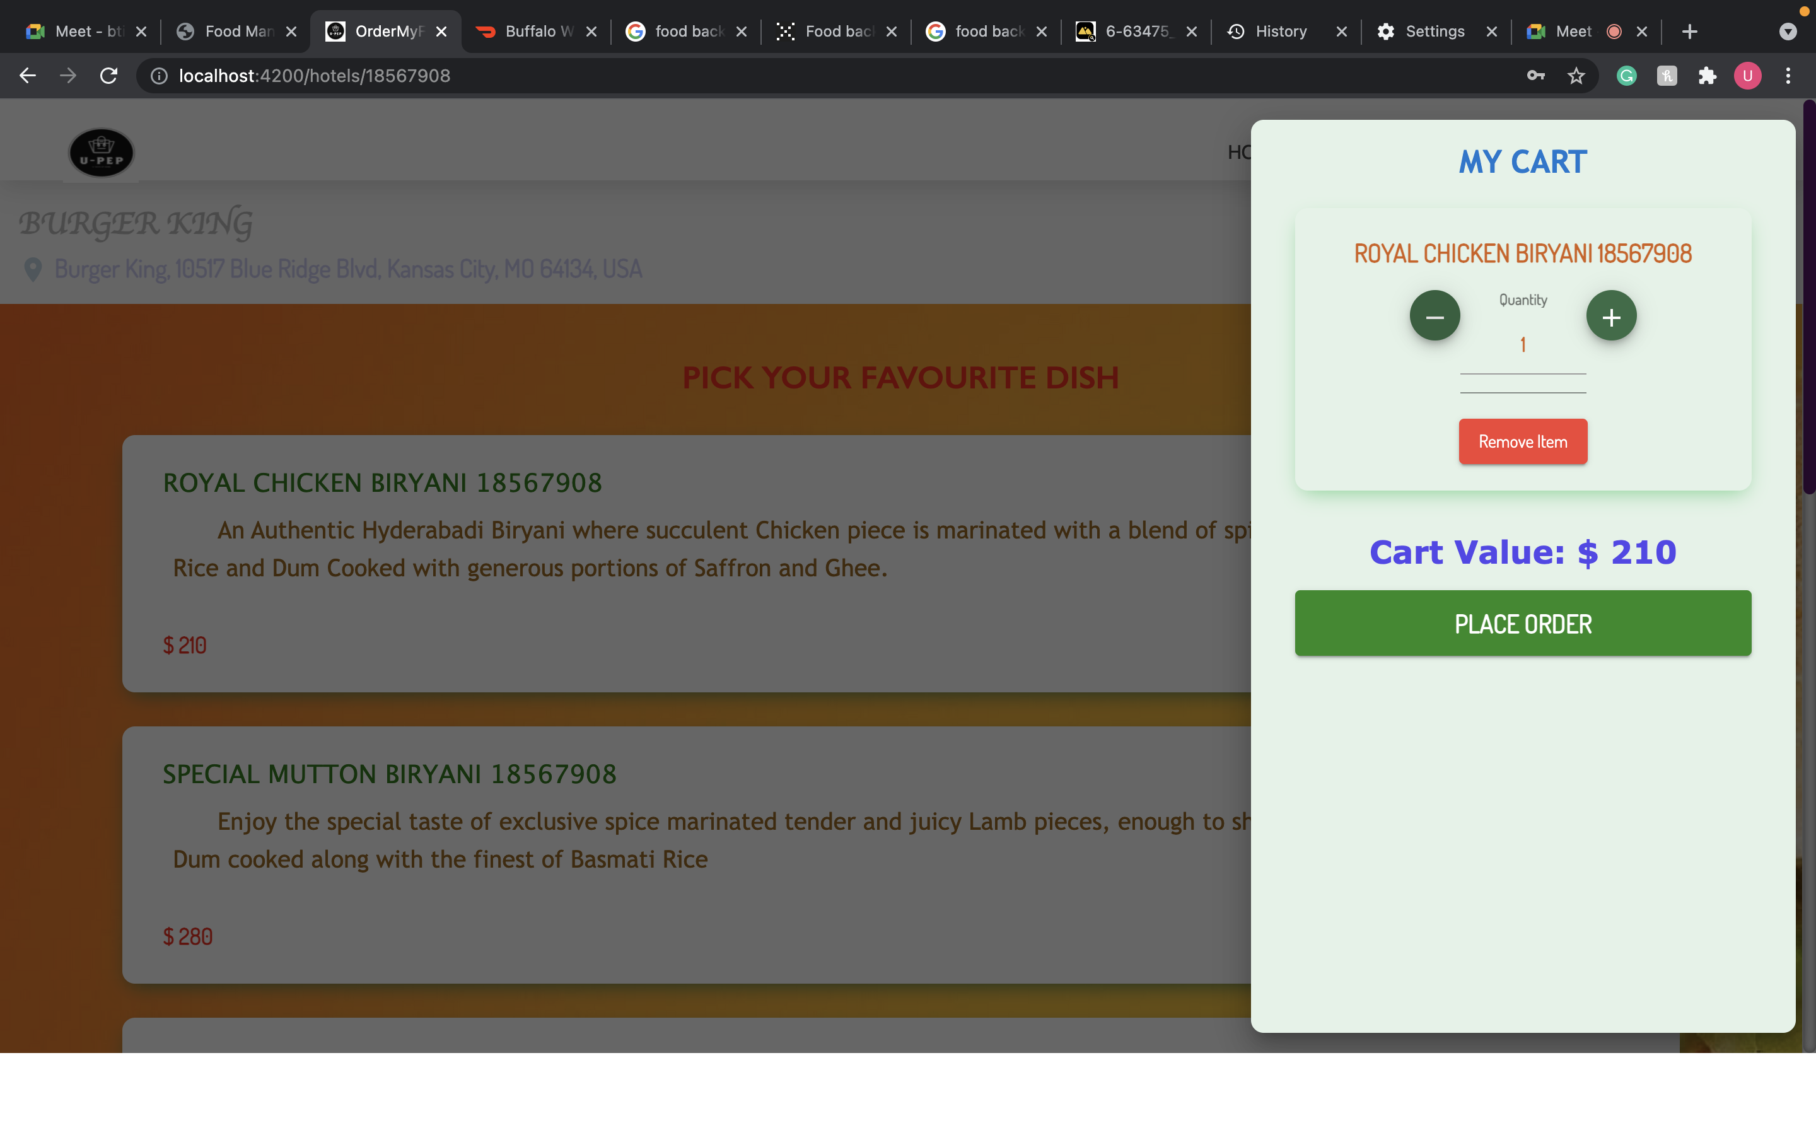
CART

Slide 10
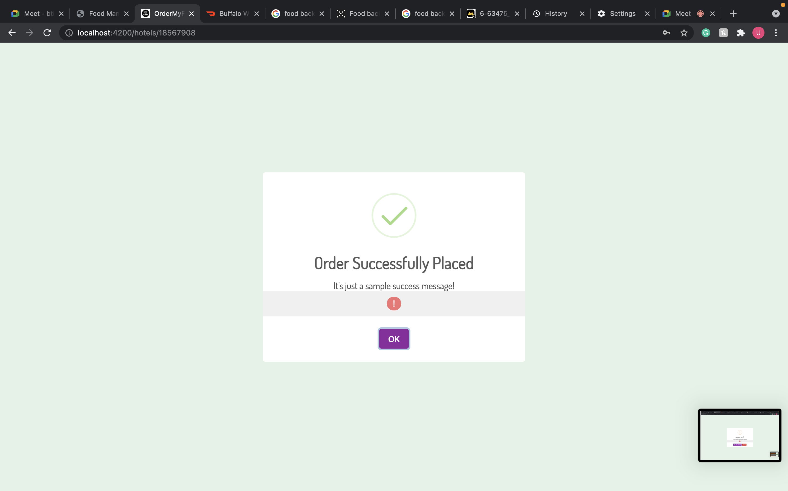
ORDER CONFIRMATION

Slide 11
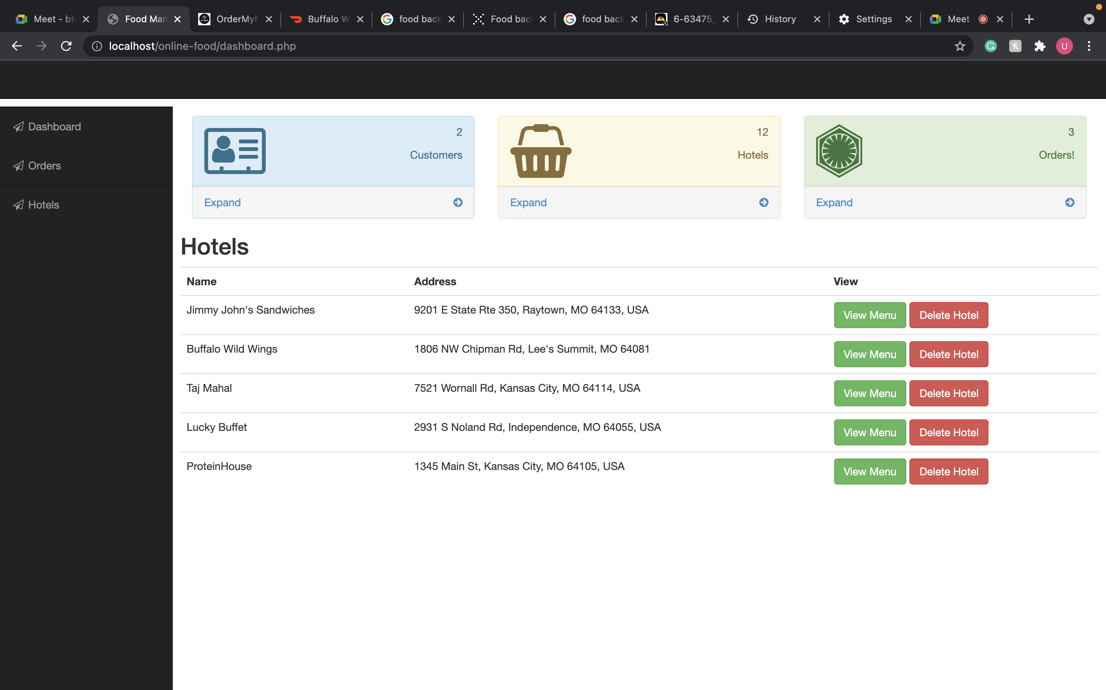
ADMIN PANEL

Slide 12
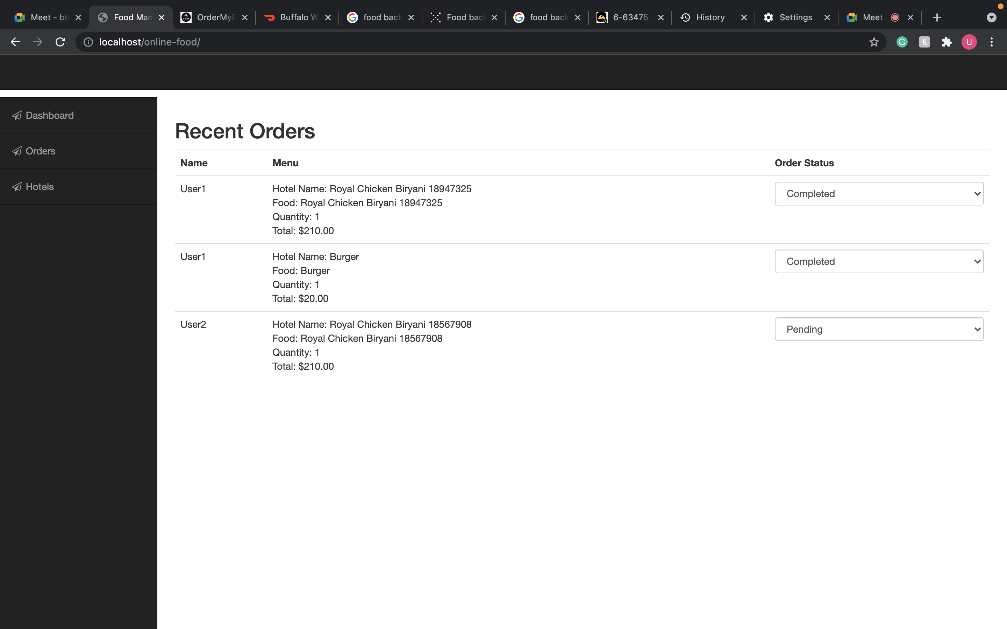
ORDERS

Slide 13
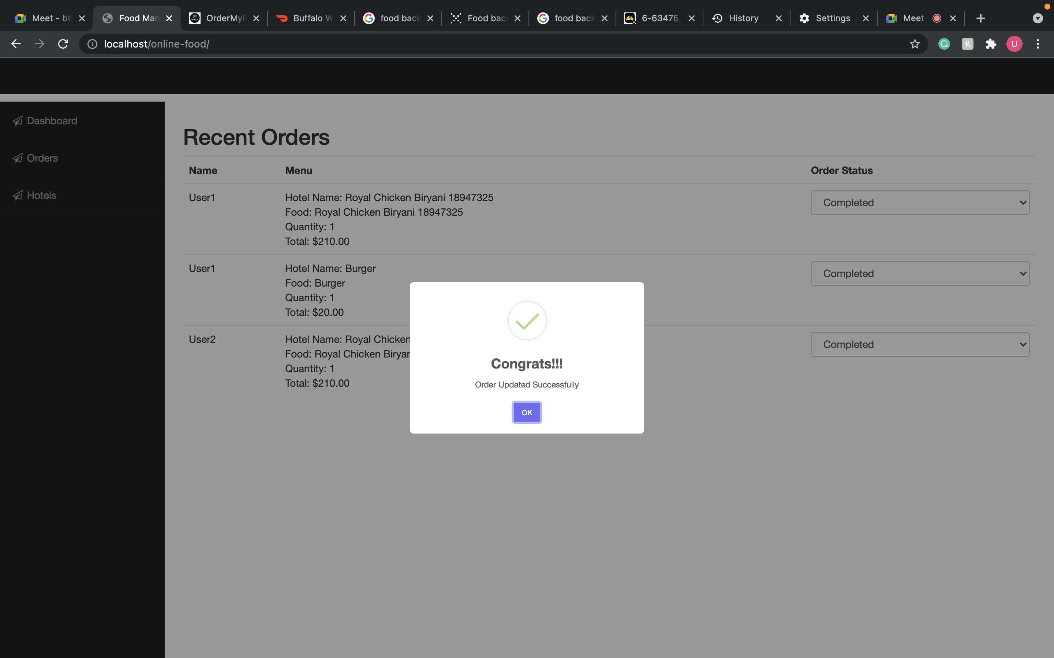
ORDERS

Slide 14
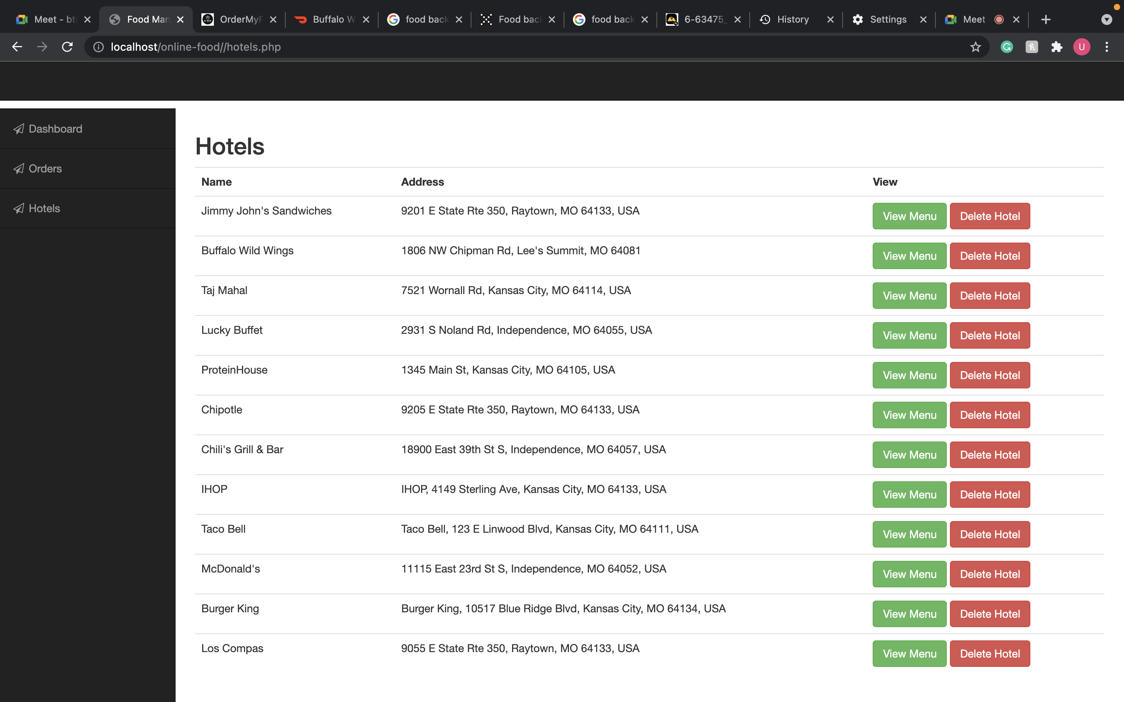
HOTELS

Slide 15
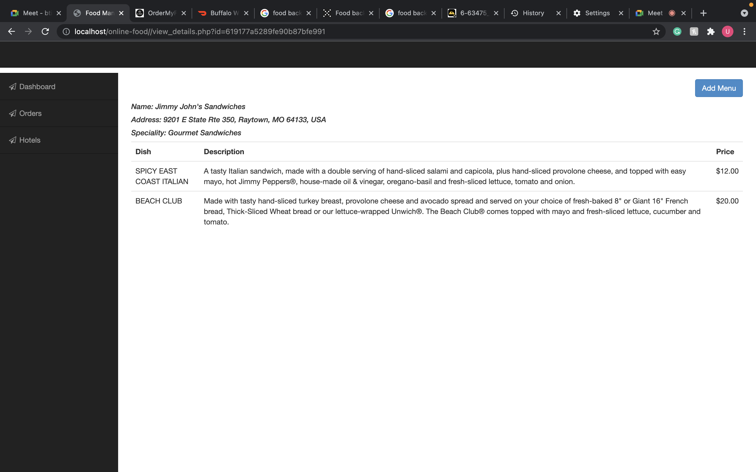
MENU

Slide 16
Work Distribution
MUHAMMAD USMAN & RITWIK REDDY taking care of the Backend framework and managing overall project.
ARAVIND REDDY & DAMODAR REDDY is working on the front-end design of the website.
All team are working on collecting the data and completing the documentation.

Slide 17

SUGGESTIONS ?

Slide 18

THANK YOU

Slide 19
Reference
https://www.spaceotechnologies.com/create-online-food-ordering-system-guide/
https://www.youtube.com/watch?v=WEqOr-clmMM
https://www.youtube.com/watch?v=dMQFT270axQ
https://www.youtube.com/watch?v=UrfhqE7I-3o

